Slide 1
PED2140Drama

Slide 2
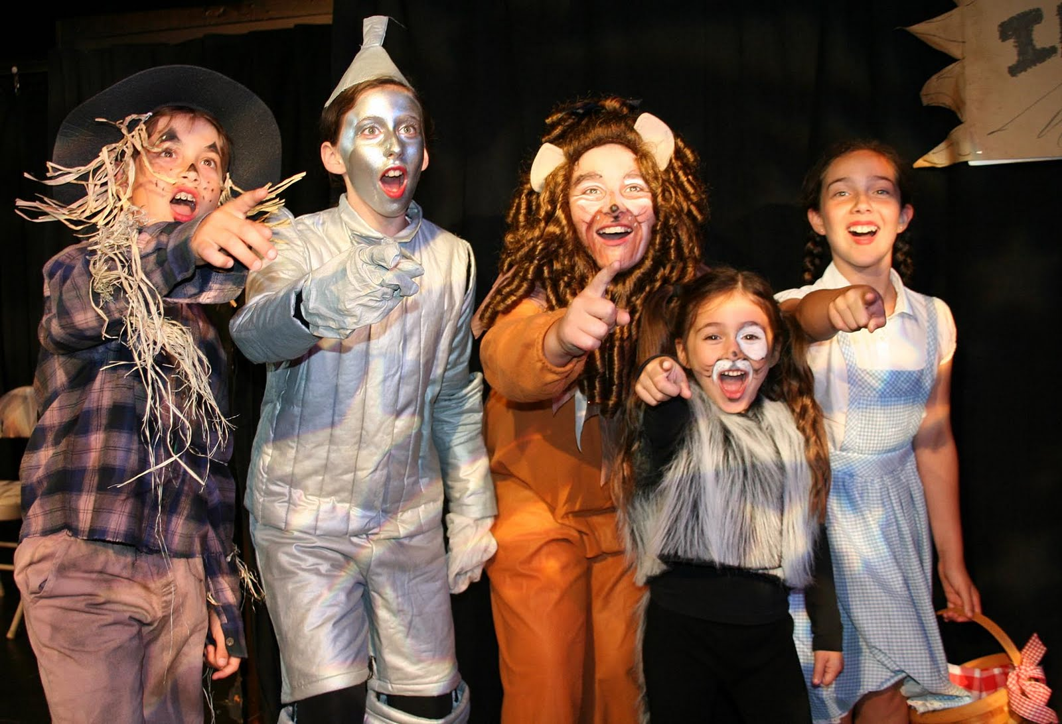
Drama
Theater:
  Concerned with communications between actors and audience.
Drama:
  Concerned with the experience of the participants.
Creative/educational Drama:
  Participant and process centered, with the teacher guiding students through explorations of personal experiences, social issues, or pieces of literature.
  (2001, Cornett & Smithrim, p.213)

Slide 3
Dramatic Skills
Use of body:
  Control, coordination, energy, sensory awareness, gesture, expression, nonverbal communication.
Verbal expression:
  Clarity, volume, tone, pitch, emphasis, pause, fluency, improvising dialogue.
Focus:
  Concentration, involvement, believability, following direction.
Imagination:
  Flexible, creative, contribution, elaboration, spontaneity.
Evaluation:
  Giving constructive feedback, taking others’ suggestions, self-evaluation, adaptation of own behavior.
Social skills and audience etiquette:
  Cooperative, attending, listening, responding appropriately to others.

Slide 4
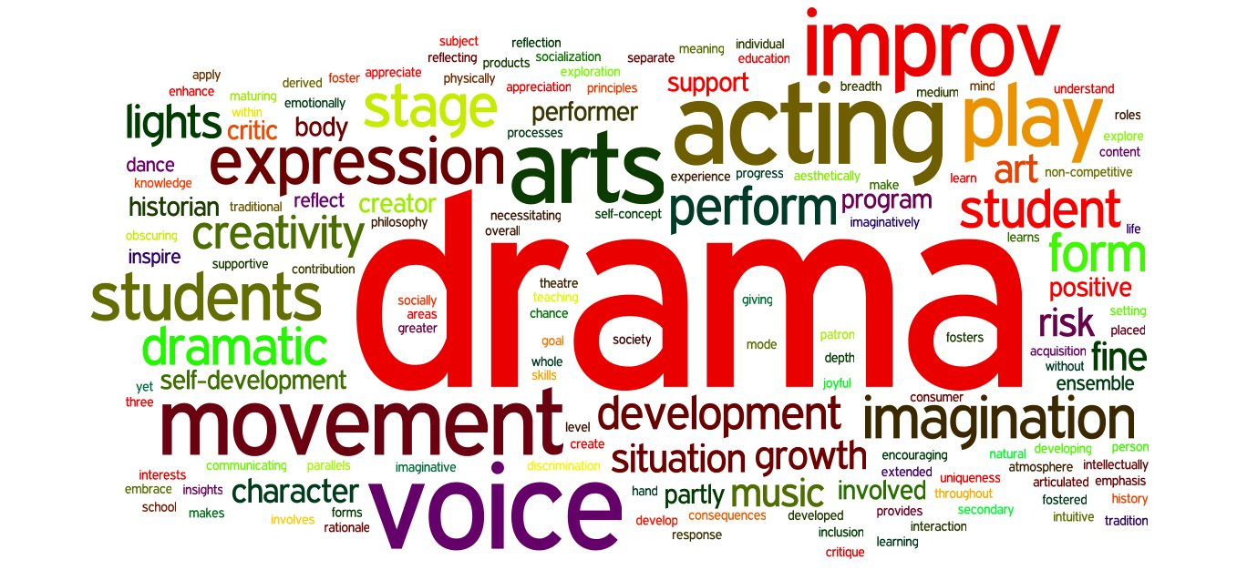

Slide 5
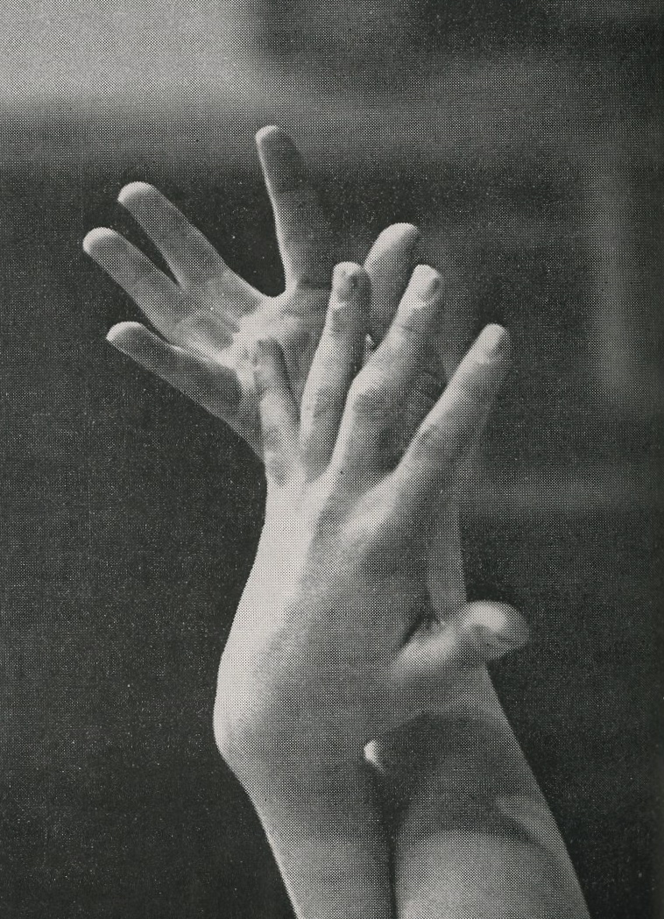
How to integrate drama
Create an aesthetic environment that supports all the arts.
Teach drama skills and concepts.
Develop good teacher habits: Take a drama course.
Plan and manage and develop routine
Use great children’s literature and go on field trips.

Slide 6
Elementary Creative Drama Ideas

Slide 7
Drama warm-ups
This is not a cup…
Follow the leader improve—Bubble gum.
In My Grandma’s Suitcase…
Name Game: “Ottawa, Alberta, Abbottsford, Dorval, London, Newcastle…”
Tongue Twisters **

Slide 8

Storytelling and story building
Finger plays for early primary.
Storybook Theatre – dramatizing a story **
Picture prompt – invent a story prompted by a picture *

Slide 9
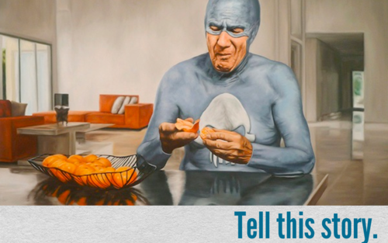

Slide 10
Movement
Walks/Freeze
  Animals (snake…butterfly…FREEZE…caterpillar…eagle…etc)
  Seasonal Activity (go fishing, carve a pumpkin, ice skate, etc) **
Tableau
  A frozen picture composed of people.

Slide 11
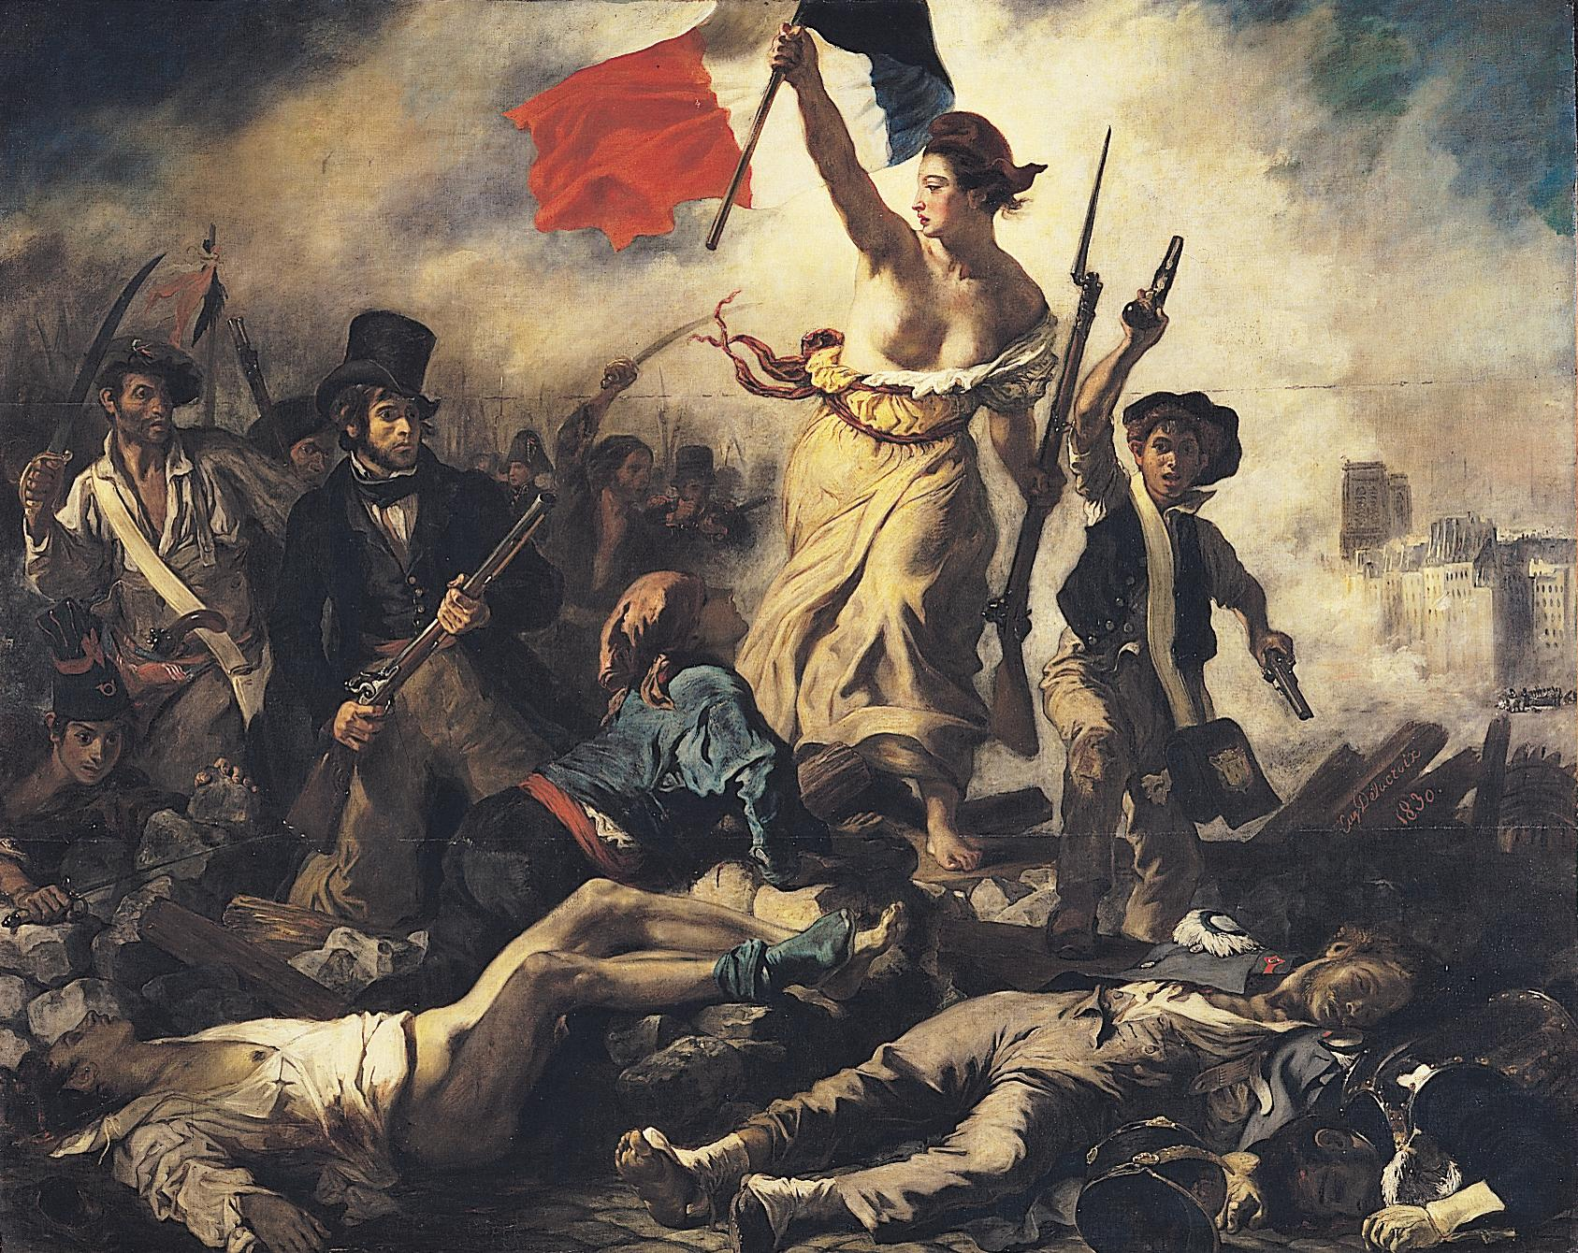

Slide 12
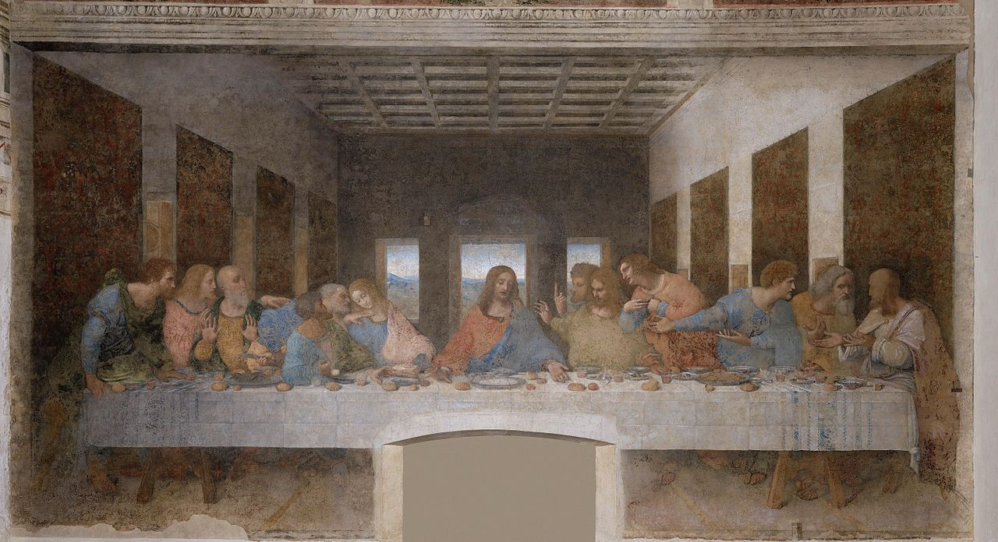

Slide 13
Staging
The Stage
ComPOSITION and levels:
  Vary levels: lying, sitting on floor, kneeling, sitting, standing, stretching.
  Focus
  Direction
  Triangle groupings:
Tableaux/artistic composition at critical points.

Slide 14
Class tableau…
A volunteer is selected.
Prof directs whole group to form a frozen picture of the sport of their choice.
Prof leaves room.
Students plan.
Volunteer invites prof back in.
Prof examines the picture –guesses sport.

Slide 15
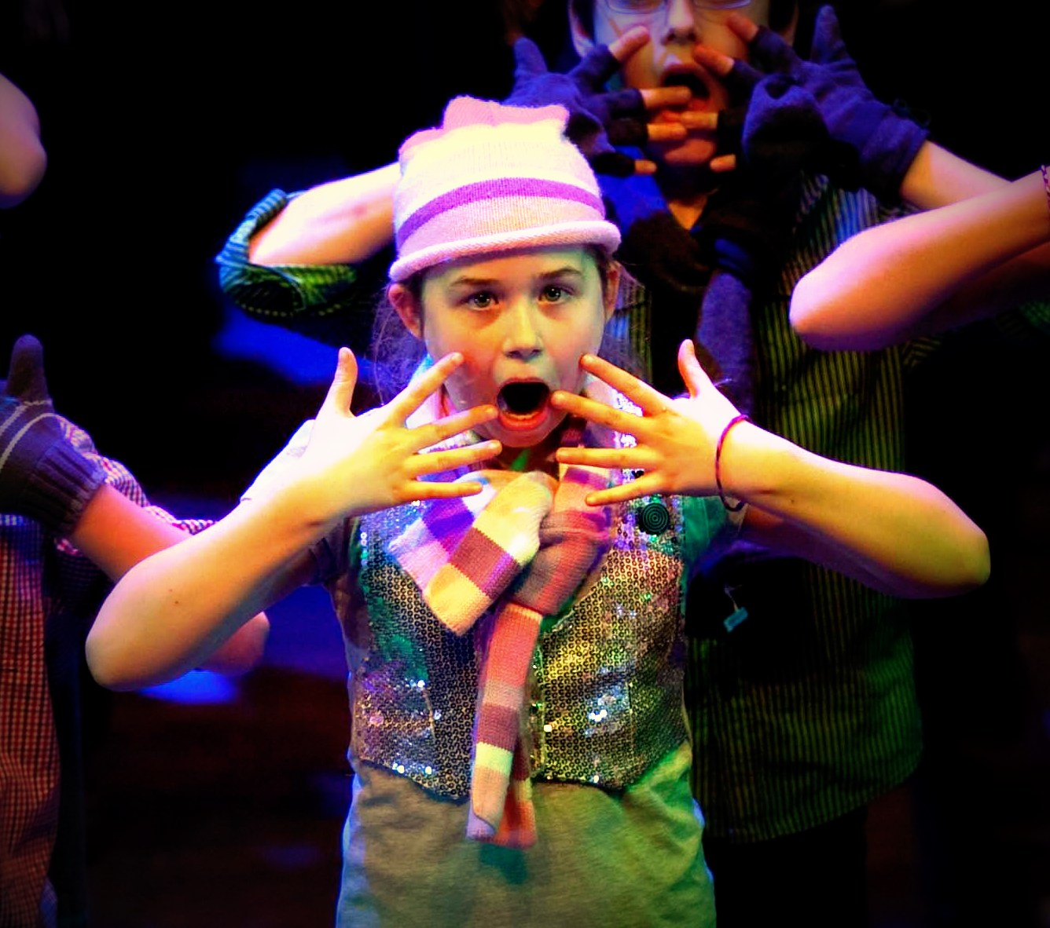
Voice
60 second talk – give topic, student talks for 60 seconds.
Coral Speaking –
  Unison, Antiphonal (2 groups), Cumulative (adding voices), Solo, Line Around (each line by a different reader).

Slide 16
Cumulative Choral Technique
#1 – I have a band-aid on my finger.
1 – 3 – One on my knee / and one on my nose, 1 – 5
1 – 7 – One on my heel / and two on my shoulder, 1 – 9
1 – 11 – Three on my elbow / and nine on my toes, 1 – 13
1 – 15 – Two on my wrists / and one on my ankle. 1 – 17
1 – 19 – One on my chin / and one on my thigh, 1 – 21
1 – 23 – Four on my belly / and five on my bottom, 1 – 25
1 – 27 – One on my forehead / and one on my eye 1 – 29
1 – 31 – One on my neck / and in case I might need ‘em, 1 – 33
1 – 35 – I have a box of thirty more.
1 – 37 – But oh! I do think it’s sort of a pity
All – I don’t have a cut or a sore!

Slide 17
Improvisation
Portrait conversations *
Charades
Deal-a-Drama **

Slide 18
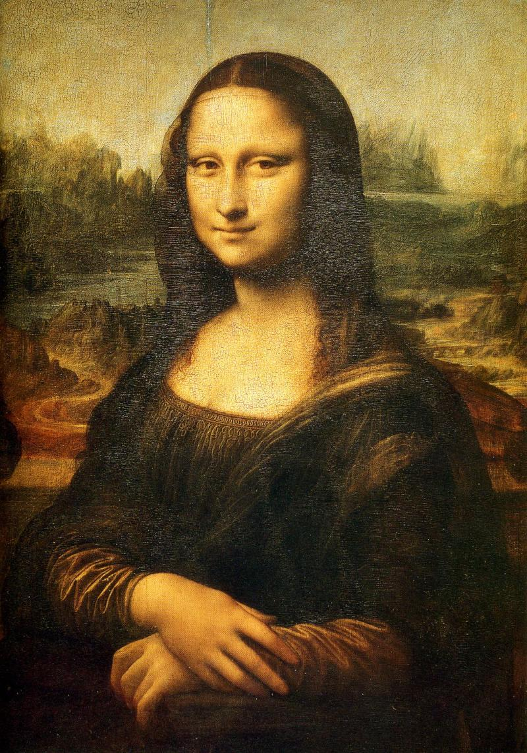
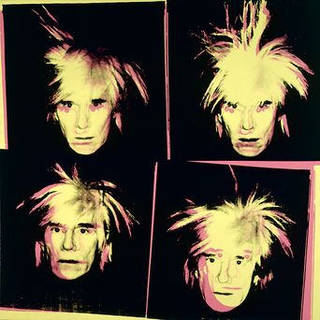

Slide 19
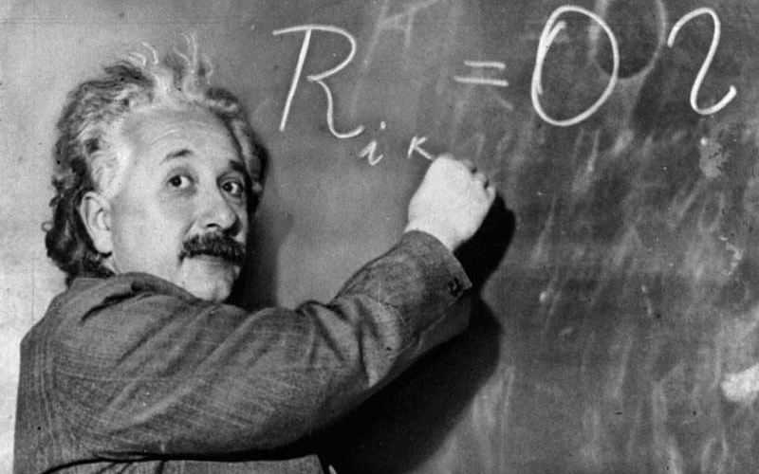
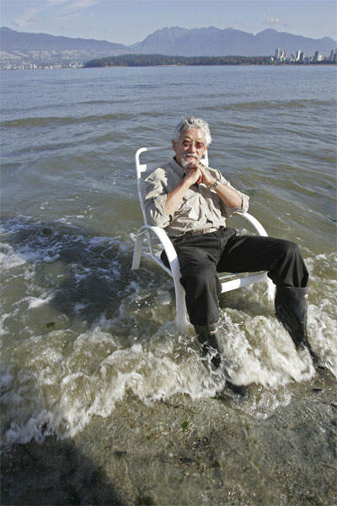

Slide 20
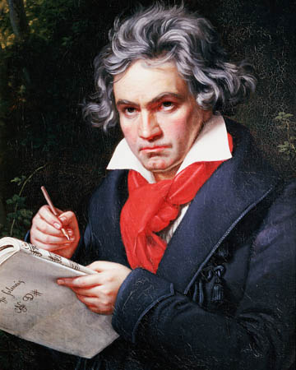

Slide 21


Slide 22
References
Wizard of Oz: http://www.completelykidsrichmond.com/wp-content/uploads/2012/10/theatre-pic.jpg
Girl actor: http://theatretrain.co.uk/wp-content/uploads/2013/02/IMG_5776b.jpg
Drama kids: http://alexforyou.com/drama_for_kids
Kid goggles: http://oneworldcamp.com/blog/wp-content/uploads/2013/12/cute_kids_cute_play-1440x900.jpg
Drama talking bubbles: http://www.culturart.co.uk/portuguese-on-the-rise-why-should-you-learn-portuguese/
Keep calm… http://creativemovements.blogspot.ca

